Slide 1
أكـــــاديميــــة طــــويـــق
Deep Learning

Slide 2
Attention Mechanism
By: Dr. Afshan Hashmi

Slide 3
Topics Covered:
Introduction to attention mechanism.
Working of Attention Mechanism.
Architecture of Attention Mechanism
Encoder, Attention and Decoder

Slide 4
Introduction to Attention Mechanisms
What is Attention?
Attention mechanisms are a powerful concept in deep learning that allow models to focus on the most relevant parts of the input when making predictions. Originally developed for Natural Language Processing (NLP), attention has since been applied to computer vision, speech recognition, and other domains.
Why Use Attention?
In traditional sequence models like RNNs or LSTMs, each word or token is processed in order, and long-range dependencies can be hard to capture. Attention addresses this limitation by assigning different weights to different parts of the input, enabling the model to dynamically decide what to "pay attention" to. Basic Idea
Given a query, attention allows the model to:
Compare the query with a set of key-value pairs.
Assign a weight (attention score) to each key.
Use the weighted combination of the corresponding values to form the output.
Analogy: Imagine reading a paragraph and trying to answer a question. You don’t re-read the whole paragraph word-by-word—you focus on the parts that seem most relevant. That’s what attention does.

Slide 5
Key Takeaways about Attention Mechanism:
Inspired by Human Attention: Attention mechanisms mimic our natural ability to focus on the most important information.
Selective Focus: They allow models to process all input but prioritize the most relevant parts for the current task.
Attention Weights: Mathematically, they compute weights indicating the importance of each input element.
Weighted Influence: These weights are used to scale the influence of different parts of the input.
Trained on Data: Attention models learn to assign accurate weights through supervised or self-supervised learning.
Revolutionized Machine Translation: Initially introduced to improve RNN-based machine translation.
Integrated into CNNs: Later applied to tasks like image captioning and visual question answering.
Transformer Architecture: The "Attention is All You Need" paper introduced a novel architecture relying solely on attention, which has become foundational for modern generative AI.
In essence, attention mechanisms provide a powerful way for neural networks to dynamically focus on the most pertinent information within a sequence or across different modalities, leading to significant improvements in performance across a wide range of tasks. The rise of the Transformer architecture further solidified the central role of attention in modern deep learning.

Slide 6
Why attention mechanisms are so important ?
State-of-the-Art Performance: Attention mechanisms have been instrumental in achieving top-tier results across a vast spectrum of deep learning tasks. Their effectiveness has been demonstrated in virtually every subdomain.
Overcoming RNN Serial Processing (Flexibility over Time):
Traditional RNNs process sequences step-by-step, making it challenging to capture long-range dependencies where relevant information is separated by many time steps.
Attention mechanisms can process the entire sequence simultaneously, allowing the model to directly assess relationships between distant elements and decide which parts to focus on, regardless of their sequential order.
Addressing CNN Locality (Flexibility over Space):
CNNs, with their convolutional operations, process local regions of the input, struggling to capture long-range dependencies in spatial data like text or images where relevant parts might be far apart.
Attention mechanisms don't have this locality constraint. They can directly compute relationships between any two positions in the input, regardless of their spatial or sequential distance.

Slide 7
Why attention mechanisms are so important ?
4.Enabling Parallelization:
The inherent design of attention mechanisms allows for many computations to be performed in parallel, rather than sequentially.
This parallel nature makes them highly amenable to acceleration using GPUs, significantly speeding up training and inference times compared to the sequential processing of RNNs.
In essence, attention mechanisms provide neural networks with a more flexible and efficient way to process sequential and spatial data by allowing them to selectively focus on the most relevant information, regardless of its position, and to do so in a highly parallelizable manner. These advantages were key to the success of Transformer models and the subsequent revolution in generative AI. The initial motivation to improve RNN-based sequence-to-sequence models for machine translation underscores their fundamental importance in handling complex sequential relationships.

Slide 8
How attention mechanisms works.
Embedding Input Sequences: The initial step involves transforming the raw input data (e.g., words in a sentence, pixels in an image) into vector embeddings. Each element in the input sequence is represented by one or more feature vectors. This embedding process converts discrete input units into continuous, dense representations that capture semantic or other relevant information.
Calculating Attention Weights: This is the core of the attention mechanism. It involves two sub-steps:
Determining Alignment Scores (Attention Scores): The mechanism calculates a score for each pair of elements in the input (or between the input and some context, depending on the specific type of attention).These scores quantify the similarity, correlation, or dependency between the vectors. Various functions can be used to compute these alignment scores (e.g., dot product, scaled dot product, concatenation followed by a linear layer).

Slide 9
How attention mechanisms works contd...
Computing Attention Weights via Softmax: The calculated alignment scores are then normalized using a softmax function. This function converts the scores into a probability distribution over the input elements.The resulting attention weights are values between 0 and 1, and they sum up to 1. A higher weight indicates greater importance, while a weight close to 0 suggests the element is less relevant for the current context.
Applying Attention Weights: Finally, the computed attention weights are used to influence the model's processing of the input. This is typically done by taking a weighted sum of the input embeddings (or some transformed version of them). The attention weights determine the contribution of each input element to this weighted sum. Elements with higher attention weights have a greater impact on the output, effectively allowing the model to "attend to" the most important parts of the input and "disregard" the less important ones.
In essence, attention mechanisms enable models to dynamically learn which parts of the input are most relevant for a given task by learning to assign appropriate weights. This selective focus is what makes them so powerful for handling complex relationships in sequential and other types of data.

Slide 10
How attention mechanisms works contd...
Computing Attention Weights via Softmax: The calculated alignment scores are then normalized using a softmax function. This function converts the scores into a probability distribution over the input elements.The resulting attention weights are values between 0 and 1, and they sum up to 1. A higher weight indicates greater importance, while a weight close to 0 suggests the element is less relevant for the current context.
Applying Attention Weights: Finally, the computed attention weights are used to influence the model's processing of the input. This is typically done by taking a weighted sum of the input embeddings (or some transformed version of them). The attention weights determine the contribution of each input element to this weighted sum. Elements with higher attention weights have a greater impact on the output, effectively allowing the model to "attend to" the most important parts of the input and "disregard" the less important ones.
In essence, attention mechanisms enable models to dynamically learn which parts of the input are most relevant for a given task by learning to assign appropriate weights. This selective focus is what makes them so powerful for handling complex relationships in sequential and other types of data.

Slide 11
Query, Keys, and Values
Relational Database Analogy: The paper draws a parallel to how databases store and retrieve information using unique keys associated with values. The model's "database" in NLP can be thought of as the learned vocabulary.
Query Vector: Represents what a specific token in the input sequence is "looking for" or its information needs in relation to other tokens. It's like a question being asked to the "database."
Key Vectors: Represent the information content of each token in the input sequence. They act like the unique identifiers or "keys" in the database, indicating what information each token "offers."
Alignment (Query-Key): The attention mechanism calculates the similarity or "alignment" between the query vector of one token and the key vector of every other token (including itself) in the sequence. This alignment score determines how relevant each token's information (key) is to the current token's need (query).
Value Vectors: Each token also has a value vector, which contains the actual information to be retrieved. The attention weights (derived from the query-key alignment) are then applied to these value vectors.

Slide 12
Query, Keys, and Values
Weighted Sum (Attention Output): Tokens whose key vectors have a high alignment with the current token's query vector will have higher attention weights. Consequently, their corresponding value vectors will contribute more significantly to the output for the current token. Tokens with low alignment will contribute less. This weighted sum of the value vectors is the output of the attention mechanism for that specific query token, representing the contextually enriched information.
Differentiation of Attention Variants: Various attention mechanisms differ primarily in:
How the query, key, and value vectors are derived (encoded) from the input.
The specific function used to calculate the alignment scores between queries and keys.
How the resulting attention weights are applied to the value vectors to produce the final output.
In essence, this "query, keys, and values" framework provides a structured way for the model to compare each part of the input (query) against all other parts (keys) to determine relevance and then selectively aggregate the relevant information (values) to produce a context-aware representation. This mechanism is fundamental to the power and flexibility of Transformer models.

Slide 13
Additive Attention (Bahdanau et al., 2014):
Motivation: Specifically designed for machine translation, particularly handling different word orderings.
Encoder: Uses a bidirectional RNN to encode input tokens.
Query: Decoder hidden state at each timestep.
Key: Encoder hidden state at each step.
Alignment Score: Calculated by a small feedforward neural network (the attention layer) with learnable weights (Wq​, Wk​, wv​).
Process:
Query (hd​⋅Wq​) + Key (he​⋅Wk​)
tanh(result)
tanh(result)⋅wv​ = Alignment Score
Softmax(Alignment Scores) = Attention Weights
Context Vector: Attention-weighted sum of key vectors.
Benefit: Doesn't require query and key vectors to have the same length.

Slide 14
Dot Product Attention (Luong et al., 2015):
Motivation: To simplify and enhance additive attention for machine translation.
Key Innovation: Uses multiplication (dot product) instead of addition for alignment scores.
Process:
Alignment Score = Query⋅Key
Softmax(Alignment Scores) = Attention Weights
Intuition: Aligned (similar) vectors yield a large dot product, resulting in a high attention weight after softmax.
Benefit: More computationally efficient than additive attention due to matrix multiplication.
Constraint: Requires query and key vectors to have the same dimensionality (dk​).
Context Vector: Attention-weighted average of key vectors.

Slide 15

Scaled Dot Product Attention (Vaswani et al., 2017):
Scaled dot-product attention is a core component in transformer architectures.
It is more computationally efficient and faster compared to additive attention.
However, in cases where the dimensionality of the key vectors (dₖ) is large, the raw dot products can have very high values.
These large values, when passed through a softmax function, lead to very small gradients during backpropagation, making optimization difficult.
To address this, the dot product is scaled down by the square root of dₖ, which helps in producing more stable gradients and improves training efficiency.
This scaling enhances the performance of dot-product attention, especially in high-dimensional spaces.
Formula:
Attention(Q,K,V)=softmax(QK^{T} /$√$dk)V

Slide 16
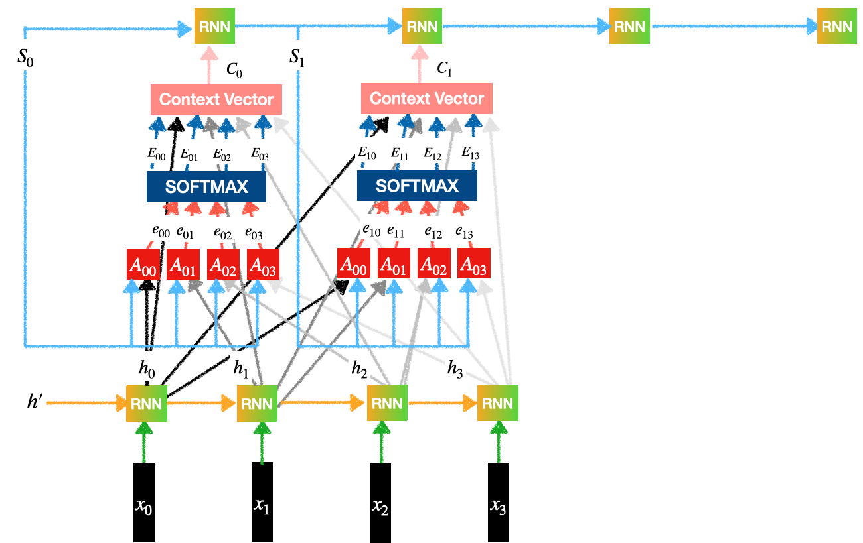
Attention Mechanism Architecture for Machine Translation
Attention mechanism in machine translation has three main components: Encoder, Attention and Decoder. Here's how each of these components works:

Slide 17
1. Encoder
Input Processing: The encoder takes the input sequence (e.g., a sentence) and processes it step by step.
Model Types: It typically uses RNNs, LSTMs, GRUs, or transformer-based models for this processing.
Hidden State Generation: At each step, the encoder produces a hidden state.
Information Encoding: Each hidden state encapsulates information from the previous hidden state and the current input token.
Relationship Capture: This mechanism allows the encoder to capture the relationships and dependencies between tokens in the input sequence.
Sequence Representation: The encoder generates a series of hidden states that collectively represent the entire input sequence.
Passing to Attention: These generated hidden states are then passed on to the attention mechanism for subsequent processing.
Importance: The encoder's role is crucial as it creates a comprehensive representation of the input, which the attention mechanism and decoder will use to generate an accurate output sequence.

Slide 18
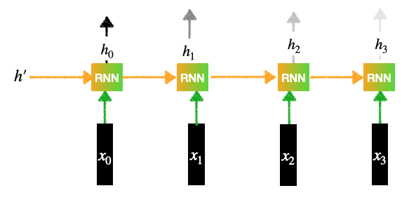
Encoder
Contains an RNN layer (Can be LSTMs or GRU):
Let's say, there are 4 words sentence then inputs will be: x0,x1,x2,x3​
Each input goes through an Embedding Layer, It can be RNN, LSTM, GRU or transformers
Each of the inputs generates a hidden representation.
This generates the outputs for the Encoder: h0,h1,h2,h3

Slide 19
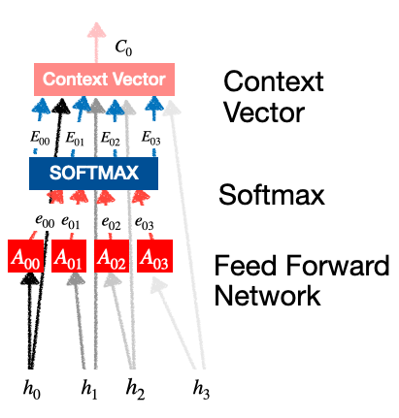
2. Attention:
Attention component find importance of each encoder's hidden state with respect to the current target hidden state. It generates a context vector that captures the relevant information from the encoder's hidden states. Its mechanism can be represented mathematically as follows:
Our goal is to generate the context vectors.
For example, context vector C1 C1​ tells us how much importance, attention should be given the inputs: x0,x1,x2,x3 .
This layer in turn contains 3 subparts:
Feed Forward Network
Softmax Calculation
Context vector generation

Slide 20
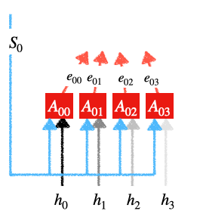
2. Attention:
a. Feed Forward Network:
It transform target hidden state into a form that is compatible with the attention mechanism. This transformation is done using a linear transformation followed by a non-linear activation function like ReLU or sigmoid. This step helps in finding alignment between target and the encoder's hidden states.
Each A00,A01,A02,A03 is a simple feed-forward neural network with one hidden layer. The input for this feed-forward network is:
Previous Decoder state
The output of Encoder states.
Each unit generates outputs: e00,e01,e02,e03
i.e e0i=g(S0,hi)
Here g can be any activation function such as sigmoid,
tanh or ReLu.

Slide 21
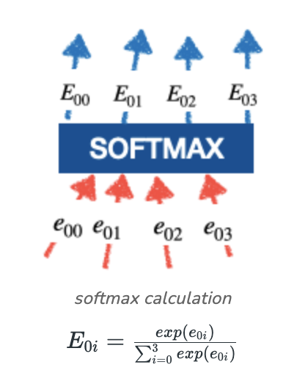
2. Attention:
b. Softmax Calculation:
Once the feed-forward network generates the relevant scores these scores are passed through a softmax function. It converts scores into probability-like attention weights. These weights indicate the relative importance of each encoder's hidden state in generating current target token. For example higher attention weights shows that a particular encoder's hidden state is more important for the current step in the decoding process.
These E00,E01,E02,E03 are called the attention weights. It decides how much importance should be given to the inputs x0​,x1​,x2​,x3​ .

Slide 22
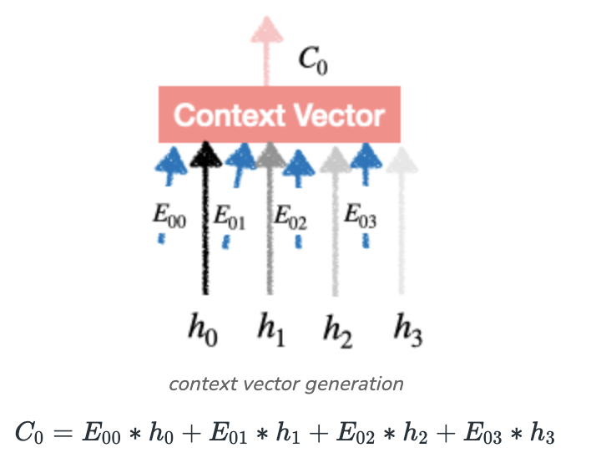
2. Attention:
c. Context Vector Generation:
When the attention weights are calculated they are applied to encoder's hidden states which helps in generating a weighted sum. This weighted sum forms the context vector which finds most relevant information from the encoder's hidden states based on their attention weights.
We find C1,C2,C3 in the same way and feed it to different RNN units of the Decoder layer. So this is the final vector which is the product of Probability Distribution and Encoder's output which is nothing but the attention paid to the input words.

Slide 23
3. Decoder:
Input: Receives a context vector from the attention layer (containing relevant encoder information) and its own current hidden state.
Prediction: Uses this combined information to predict the next token in the output sequence.
Hidden State Update: The decoder's hidden state is updated based on the predicted token.
Iterative Generation: This prediction and update process repeats for each token in the output sequence.
Focus on Important Parts: Enables the model to generate the output sequence (e.g., translation) word by word, focusing on the most important parts of the input at each step.

Slide 24
Applications of Attention Mechanisms:
Machine Translation: Significantly improves accuracy by focusing on relevant source sentence parts during target word generation.
Sentiment Analysis & Named Entity Recognition: Helps models identify key words crucial for tasks like sentiment classification and entity extraction.
Text Summarization: Enables the selection of important information for generating concise and accurate summaries.
Image Captioning: Allows models to focus on specific regions of an image when generating descriptive captions, enhancing detail.
Future Potential: Attention mechanisms are expected to continue improving, leading to more efficient and capable models for increasingly complex tasks.

Slide 25

Books and References
"Neural Networks and Deep Learning" (Michael Nielsen)
Deep Learning for Computer Vision (Rajalingappaa Shanmugamani)
https://www.geeksforgeeks.org/ml-attention-mechanism/
Goodfellow, I., Bengio, Y., & Courville, A. (2016). Deep Learning. MIT Press.
Chollet, F. (2017). Deep Learning with Python. Manning Publications.
Hochreiter, S., & Schmidhuber, J. (1997). Long Short-Term Memory. Neural Computation.

Slide 26


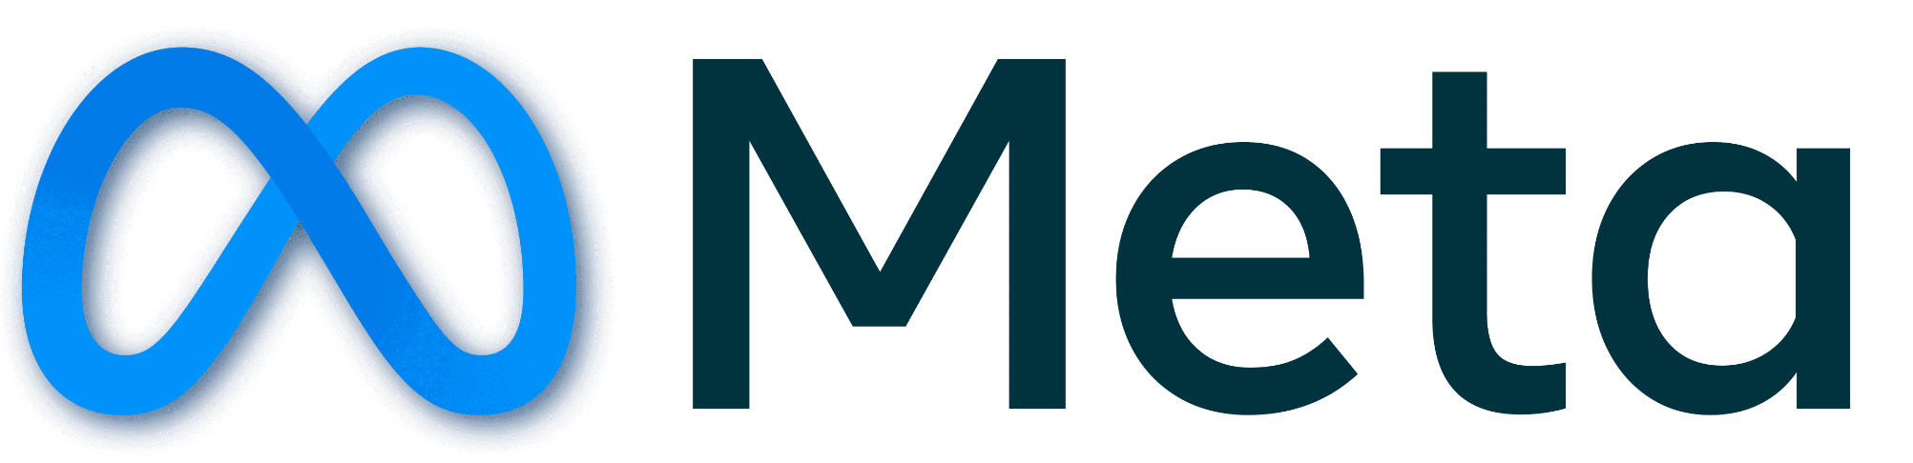














الشراكات العالمية

Slide 27
شــــــكــــرًا لكــــــم
THANK YOU

